Slide 1
Publishing Short Stories on Kindle
John Hope

Slide 2
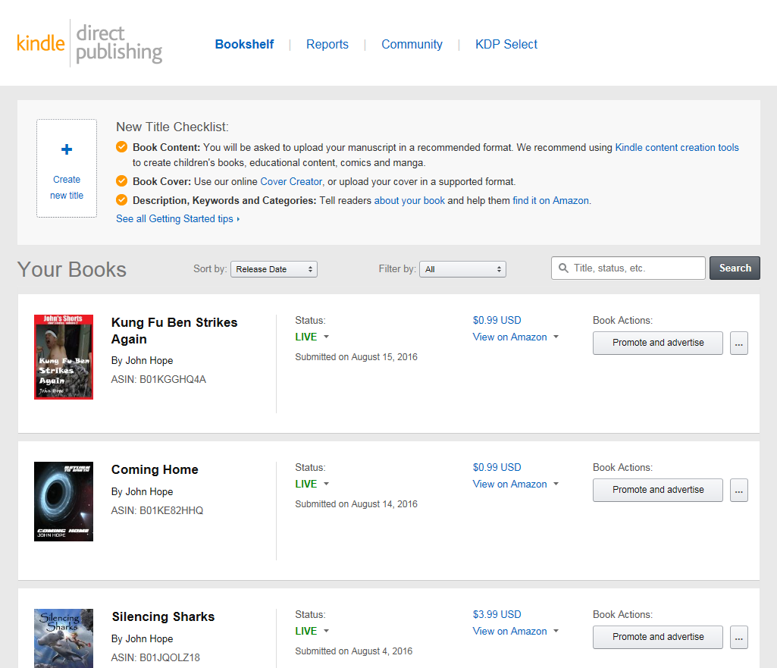
Kindle Direct Publishing
https://kdp.amazon.com
Use your Amazon account
Lots of features for managing /promoting books, including reporting stats
Click “Create new title” when ready

Slide 3
Publishing Checklist
Story Title
Publisher & Contributors
Brief Story Description
Two Story Categories
Search Keywords
Release Date
Cover Image
Formatted Word Document
Distribution & Pricing
Optional Details
Author Central Page

Slide 4
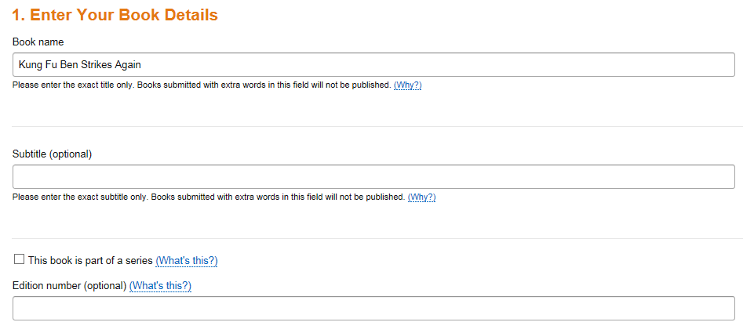
Story Title
Short and Snappy
Subtitle, Series, and Edition Optional

Slide 5
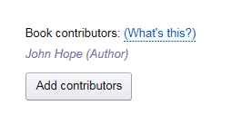
Publisher & Contributors
You are the publisher
Multiple contributors can be added; author(s), illustrator, editor, etc.

Slide 6
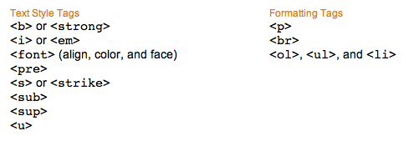
Brief Story Description
Limited to 4000 characters
Well-written
Can use limited HTML

Slide 7
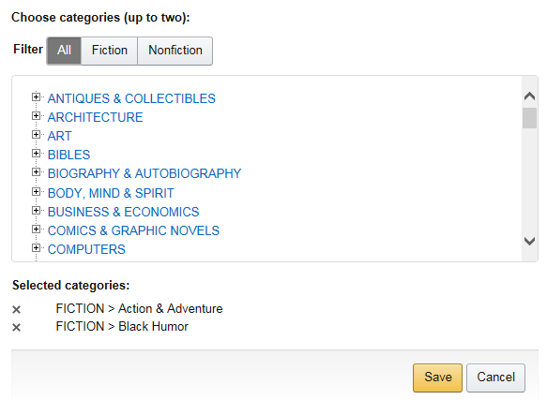
Two Story Categories
Used to target audience

Slide 8
Search Keywords
VERY USEFUL – do not skip this step
Words and phrases separated by commas
What Amazon users would type into a search
Come up with 7

Slide 9
Release Date
Release now or pre-order

Slide 10
Cover Image
JPEG or TIFF files only
Ideal Ratio: 8:5
Smallest: 625px wide x 1,000px tall
Largest: 6,250px wide x 10,000px tall
Nothing Amazon deems “offensive”
Licensed or Used by Permission Only
Cannot be “freely available” from Internet
Can credit photographer / illustrator within book (on Copyright Page)

Slide 11
Cover Image
Sources
shutterstock.com
istockphoto.com
gettyimages.com
freelancer.com
Photo Editing
Adobe Photoshop
Pixlr.com
Microsoft Paint

Slide 12
Formatted Word Document
Exact format is not set in stone
Should contain the following
Title Page
Story Content (new page per chapter)
Dedication / Special Thanks Pages (optional)
About the Author Page (recommended)
Additional Works Page (recommended)
Copyright Page – place toward the end for eBooks

Slide 13
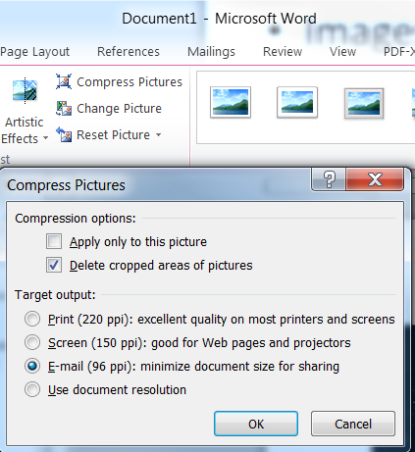
Formatted Word Document
Smaller File Sizes are better
Images
Lower resolution (96 ppi)
Compress Pictures

Slide 14
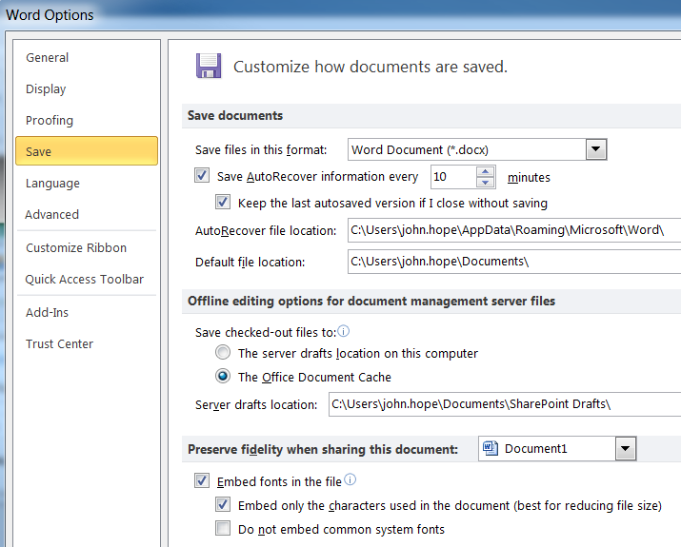
Formatted Word Document
Embed fonts in file
Word Options, Save Category

Slide 15
Formatted Word Document
Some Word items will be ignored
Page Size
Headers and Footers
Comments
Some Features may not convert well
Tables
Shading
May want to convert into images and insert images

Slide 16
Formatted Word Document
Once ready, upload
Conversion process takes a few minutes
Provides Spell Check

Slide 17
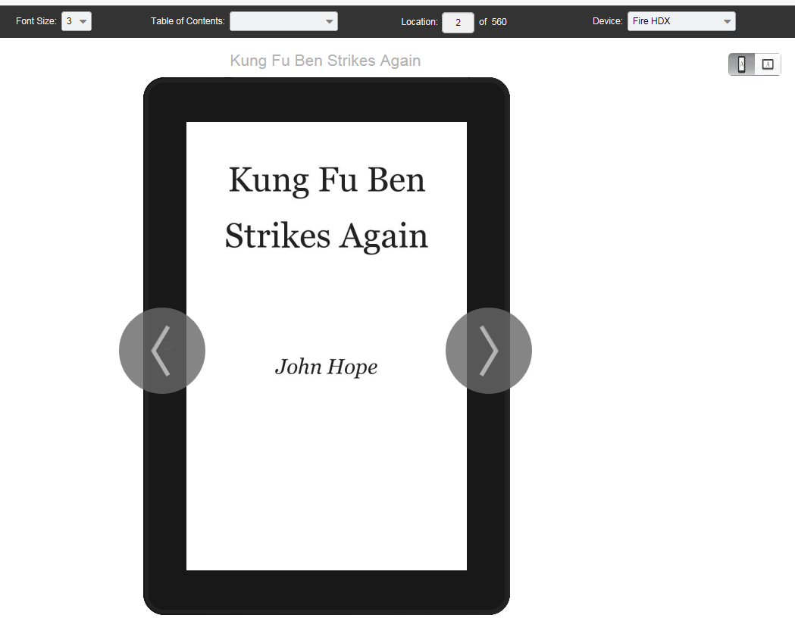
Formatted Word Document
Preview Book

Slide 18
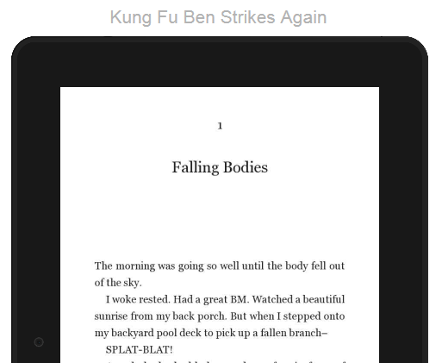
Formatted Word Document
Story Content
Divide into chapters, even for short stories

Slide 19
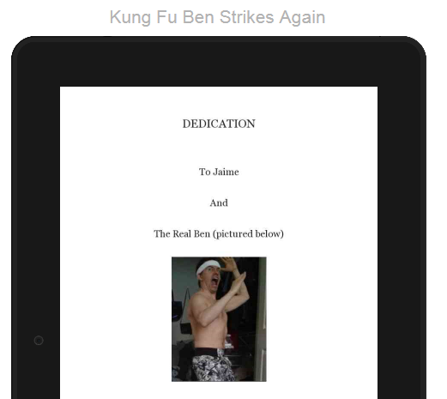
Formatted Word Document
Dedication / Special Thanks Pages

Slide 20
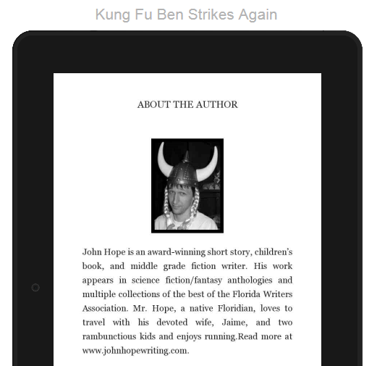
Formatted Word Document
About the Author

Slide 21
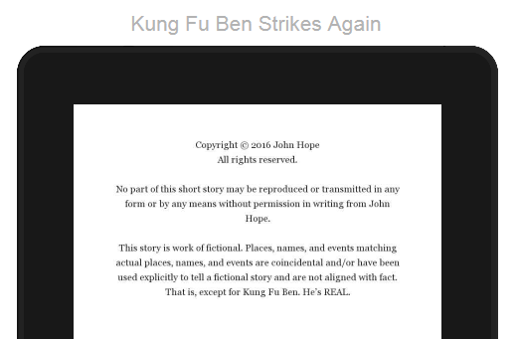
Formatted Word Document
Copyright Page

Slide 22
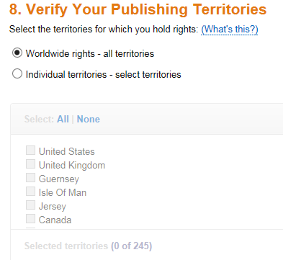
Distribution & Pricing
Recommended worldwide rights

Slide 23
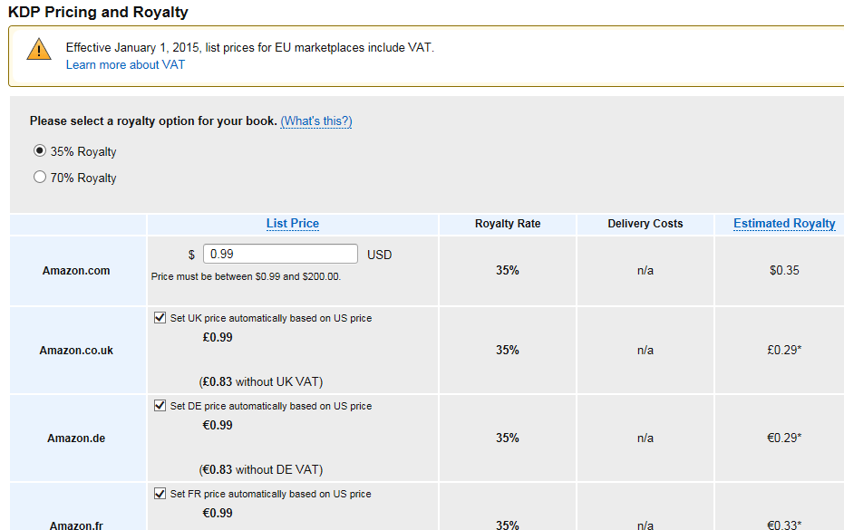
Distribution & Pricing
For short stories, recommended price: $0.99
For books, at least $4-$5 less than paperback
35% or 70% Royalty options
70% option only available $2.99 to $9.99

Slide 24
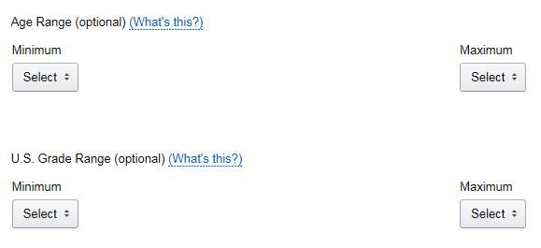
Optional Details
DRM stops people from exporting to eBook file
Optional Age /Grade Range

Slide 25
Optional Details
KDP Select
Highly recommended
Allows promoting via Amazon
Makes eBook exclusive to Amazon

Slide 26
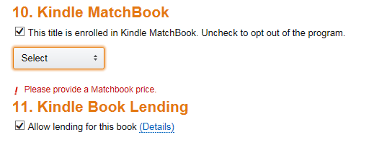
Optional Details
Kindle MatchBook
Set a lower price if Amazon customer buys the paperback first
Kindle Book Lending
Allow customers to lend eBook to friends

Slide 27
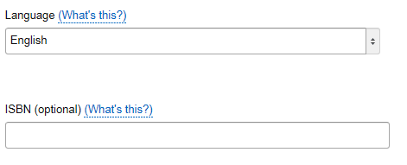
Optional Details
Language
The language the story is written
Doesn’t affect who it’s sold to
ISBN
Leave blank unless you purchase a ISBN

Slide 28
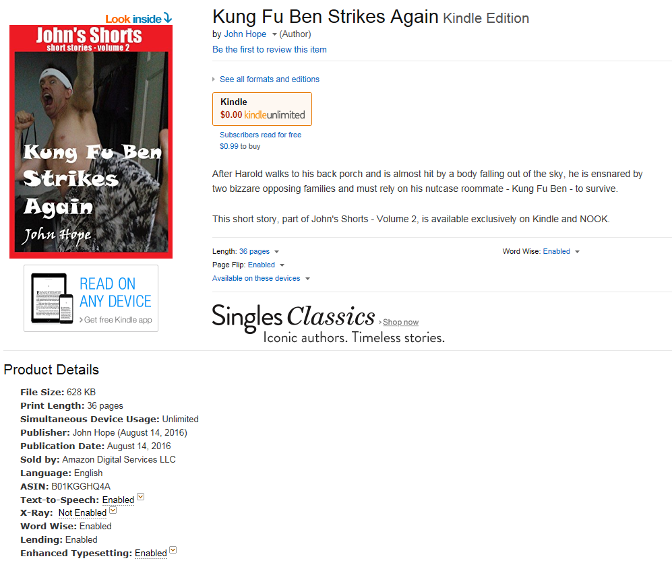
Publishing
Save and Publish
Amazon reviews and approves
Once published, search on Amazon.com
Record ASIN
Link:
https://www.amazon.com/dp/B01KGGHQ4A

Slide 29
Author Central Page
Separate Login (still uses Amazon account)
https://authorcentral.amazon.com

Slide 30
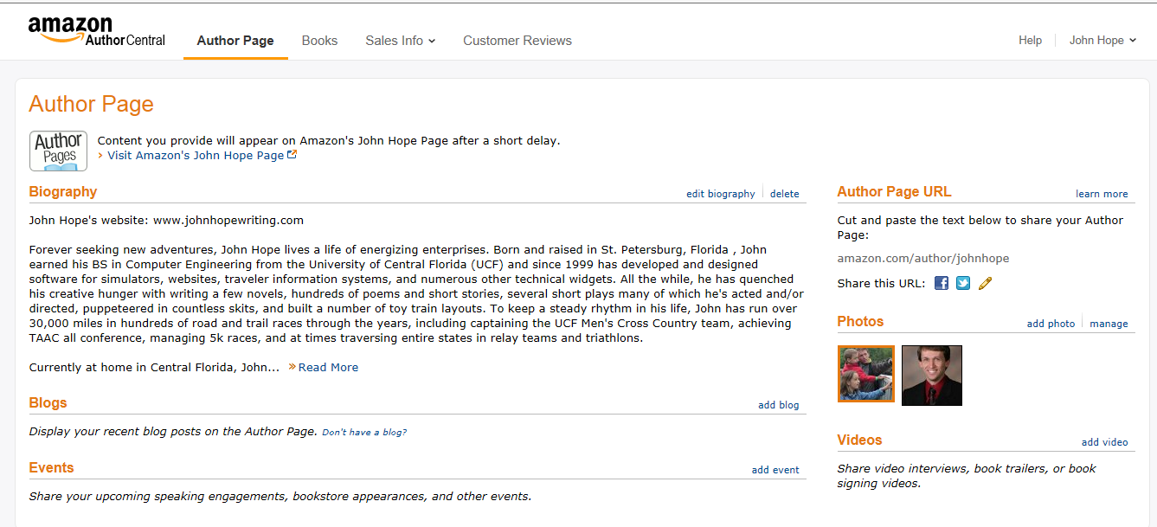
Author Central Page
Edit Author Page

Slide 31
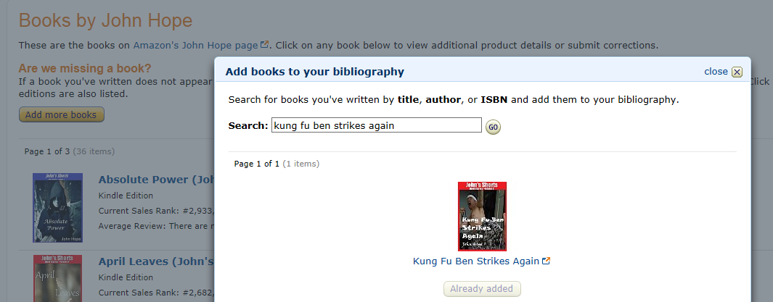
Author Central Page
Under “Books”, Click “Add more books”

Slide 32
Author Central Page
Accessible when Amazon Customers view your book

Slide 33
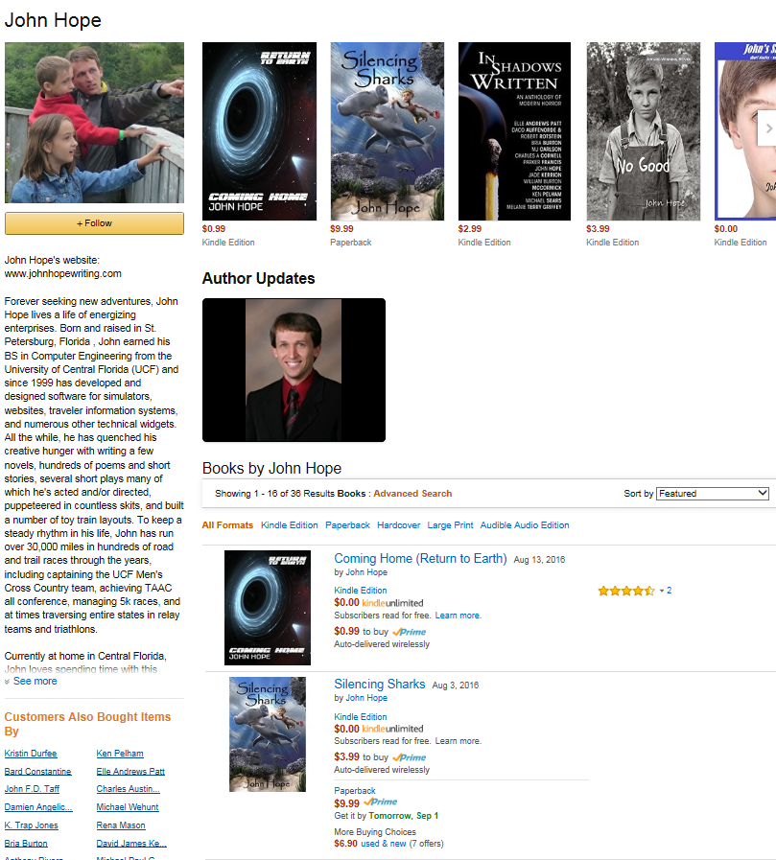
Author Central Page

Slide 34
Questions?
John Hope
john@johnhopewriting.com

